Slide 1

Los Angeles Homelessness Project
Presented By
Pratiksha Kar Roselyn Byrd Siddharth Jain
Youran Gui Wenting Zhao

Slide 2
CONTENTS
Recommendations
Shelters by YoY Change
Crime
Property Value Analysis
Mental Health Centers
Interactive Dashboard
Q & A

Slide 3

Hotspot Detection
Recommendations
Build Shelters in Safe Areas
Partner with Existing Women Shelters
Collaborate with Mental Health Centers
Investing in Property in Hot Spot Areas
Empowering the Homeless

Slide 4

Shelters by YoY Change
YoY Change in Homeless Count
Change in Homeless Count vs. Shelters

Slide 5
YoY Change in Homeless Count
Council districts in LA County with the highest decrease in homeless count (2016-2017)
Council districts in LA County with the highest increase in homeless count (2016-2017)

Slide 6
Change in Homeless Count vs. Shelters
Optimizing the number of shelters present in these high count district
Areas of interest: Antelope Valley, Pacoima NC, East Los Angeles, Montebello, Skid Row, Empowerment Congress Southeast NC

Slide 7

Crime
Homeless Density vs. Crime
Homeless Density vs. Crime by Gender
Women Shelters
Notes:
Public funding for housing and support service is actually cheaper than funding for police and court to manage homelessness
move on to school, jobs, and in some cases, independent living.
Introduce the dataset

Slide 8
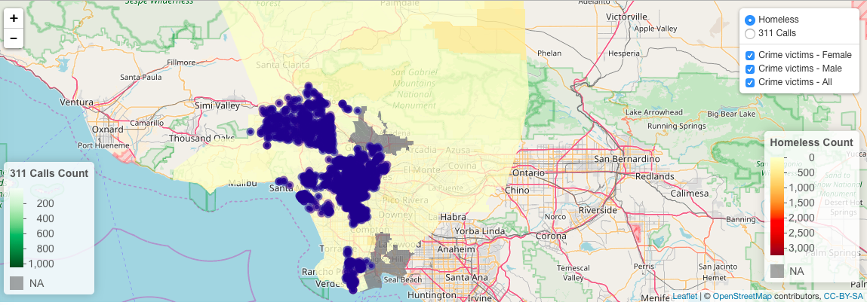
Homelessness Density vs. Crime
Observations:
There are 4 main clusters of crimes (blue dots): DTLA, North Hollywood, Santa Monica and San Pedro
Homeless data is not available in these 2 areas (shown in grey)
Notes:
Thanks Pratiksha! Now I will be sharing insights about crime
Here is a big picture of homeless and crime distribution. Yellow layer is homeless density and purple dots. In most of areas, the more homeless ppl are, the more homeless victims are there.
There are 4 main clusters of crimes

Slide 9
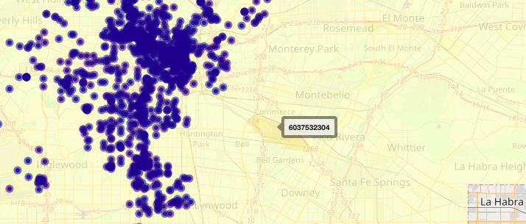
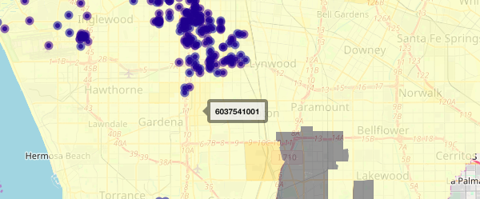
Homelessness Density vs. Crime (Cont’d)
Observations:
Some places are with high homeless density but low crime rate
(e.g. 6037532304, 6037930200, 6037543305)
These are the safe areas and shelters can be set up there
Notes:
However, we also noticed some census tract with high volume of homeless while low number of crime, such as census tract near monterey park and census track near gardena
- in another word, those are safe places and shelters can be set up to provide protection

Slide 10
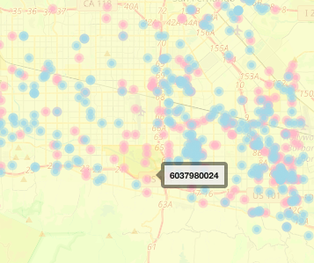
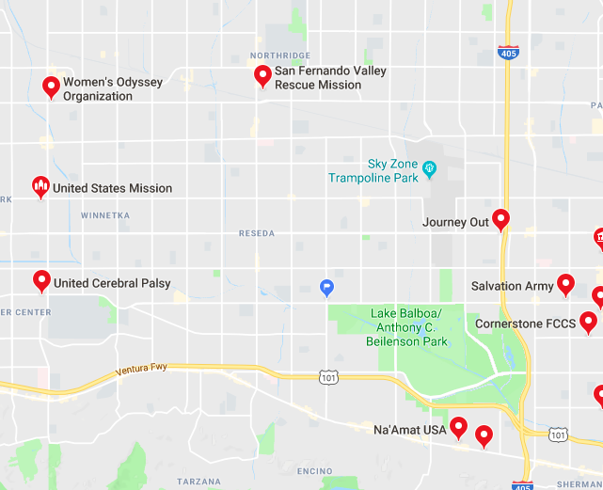
Homelessness Density vs. Crime by Gender
Female
Male
Source: Google Map
Observations:
Female and male victims are not evenly distributed
Some places only saw female victims (e.g. 6037980024)
0 shelter in that area from provided dataset
Extra women shelters appeared in Google map search (e.g. Na'Amat USA)

Slide 11
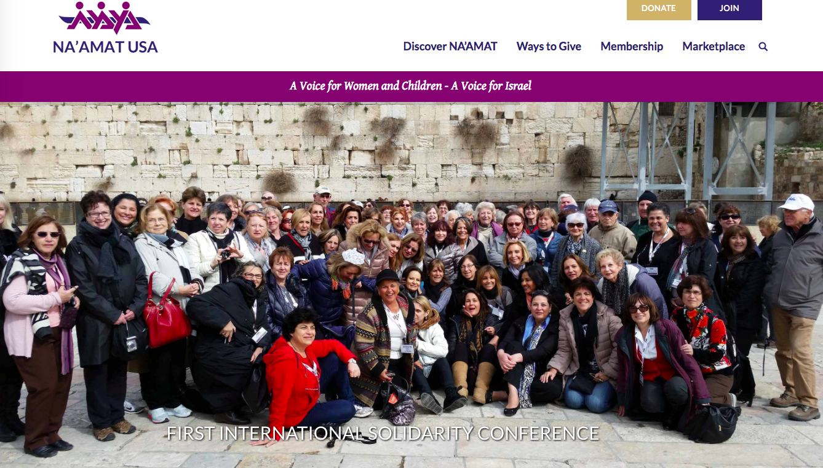
Notes:
partnership opportunities

Slide 12

Property Value Analysis
Analyzing lower-priced property for future shelter development

Slide 13
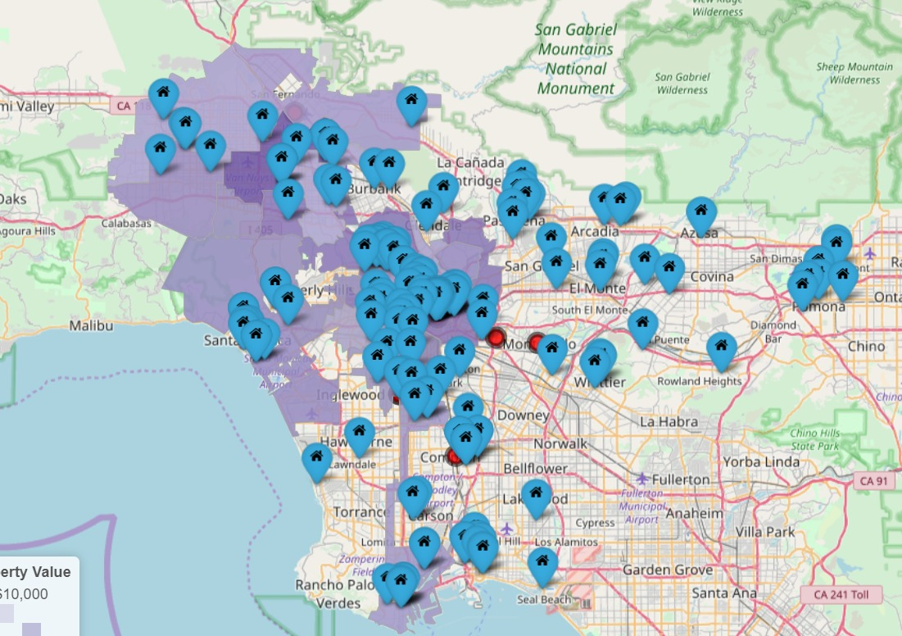
Property Value Analysis
Vulnerable Areas with rise in homelessness, low concentration of shelters and low property value

Slide 14
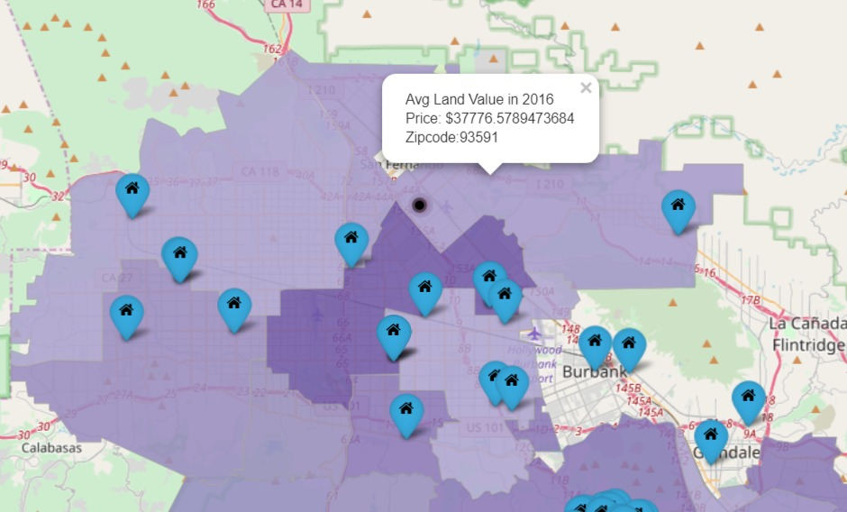
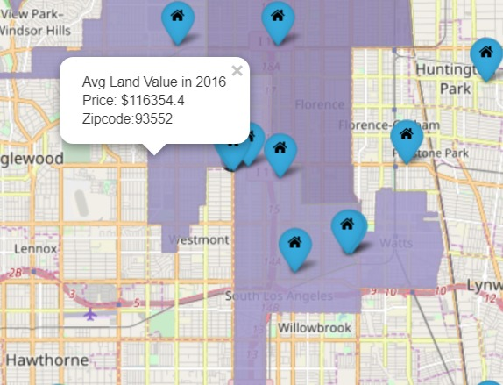
Identified Hot-Spots
1
2
Hot Spot One (North LA):
Zipcode: 93591
Mean Property Value: 37k
Hot Spot Two (SW LA):
Zipcode 93552
Mean Property Value: 116k

Slide 15

“Local authorities estimate that 30% of Los Angeles County’s homeless have severe mental issues. ”
-- Los Angeles Times
Notes:
Most ppl suffer from schchiphonia, bipolar, depression and so forth
Studies show that psychotic individuals are much more likely to get assaulted or threatened while homeless;

Slide 16

Mental Health Centers
Homeless Density vs. Mental Health Center Location
Recommendations
Source: Los Angeles County Open Data

Slide 17
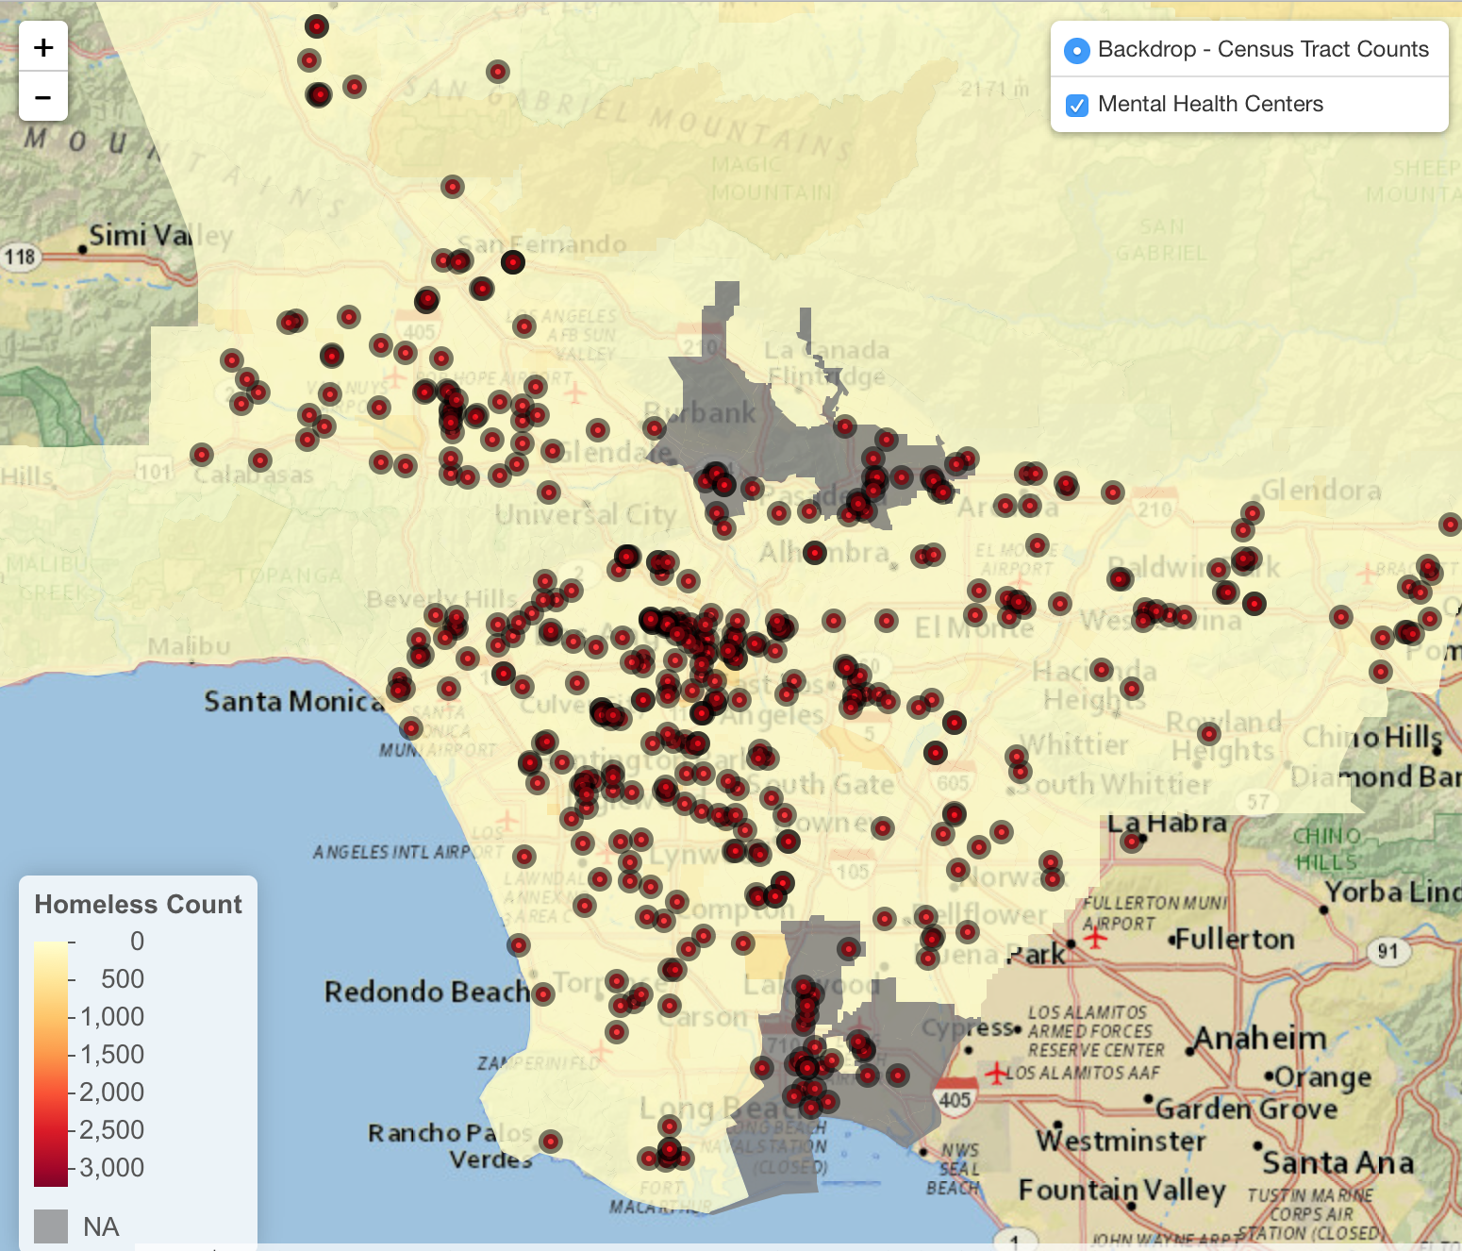
Homelessness Density vs. Mental Health Centers
Observations:
High Homelessness Density & Close to Mental Health Shelters
(e.g., Census Tract: 6037206300)
Recommendation:
Partner with local mental health centers to provide mental counseling service
Notes:
How to clean data, firstly download the dataset from http://geohub.lacity.org/datasets/27f6ec28b9c74ecfb091688d41103daa_85

Slide 18
Homelessness Density vs. Mental Health Centers
Observations:
High Homelessness Density & No Sufficient Mental Health Centers (e.g., 6037532304, 6037930200)
Recommendation:
Invite counseling professionals/social workers to work in the existing shelters

Slide 19
Empowering the Homeless: Non – Profits
Organization
Non - Profit "Chrysalis" - Long Term Solution
Enabling Homeless people to enter the workforce again

Slide 20
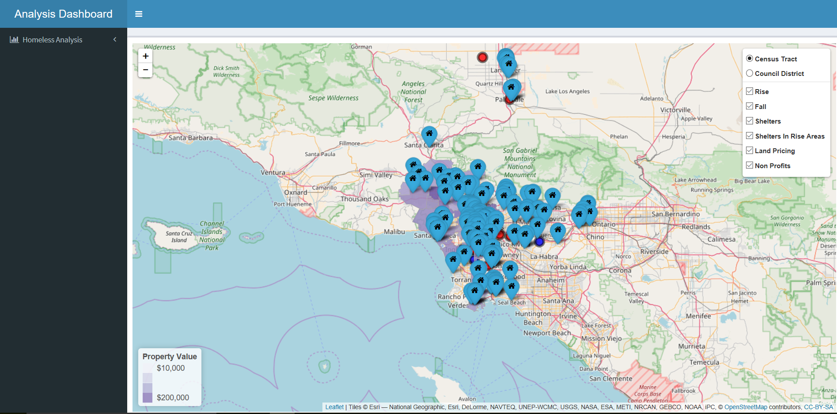
Interactive Dashboard
Notes:
Dashboard graph and hotspots preview

Slide 21

CREDITS
Special thanks to:
City of Los Angeles Data Science Federation
USC Data Science and Operations, Professor Abbass Sharif
County of Los Angeles Open Data: Parcel 2016, Mental Counseling Services 2016-2017
Google Maps
USC Marshall Social Entrepreneurship Program, Professor
Adlai Wertman

Slide 22

THANKS!
Presented By
Pratiksha Kar Roselyn Byrd Siddharth Jain
Youran Gui Wenting Zhao

Slide 23

Q & A

